Slide 1

Recommendations
General:
Unified title slide
Unified timeline slide (for people talks)
New recommended slide template (from Mel)
  Sarpong group lit template
  All structures same size
  Example reaction schemes etc.
Remove transitions that overlap (every slide should be readable)
Recommend slides are explicit, should be very little information in presentation that is not on the slide
Recommend “takeaway” messages on each slide to summarize information
References should have descriptions on the slide and be ACS format
Presentations should be proofread for accuracy
Sent to Website job as a PDF
Useful video for making catalytic cycles: https://www.youtube.com/watch?v=PScK1yTvDVI

Slide 2

Title
image
Name
Sarpong Group Meeting
April 17, 2020

Slide 3
Title
Timeline (for lit talks only) – see Justin’s lit talk (on box) as example

Slide 4
Synthesis of (S)-carvone derived cyclobutanols
Ti(III) cyclization: Bermejo, F.A. et al. Tetrahedron 2006, 62, 8933–8942.

Slide 5
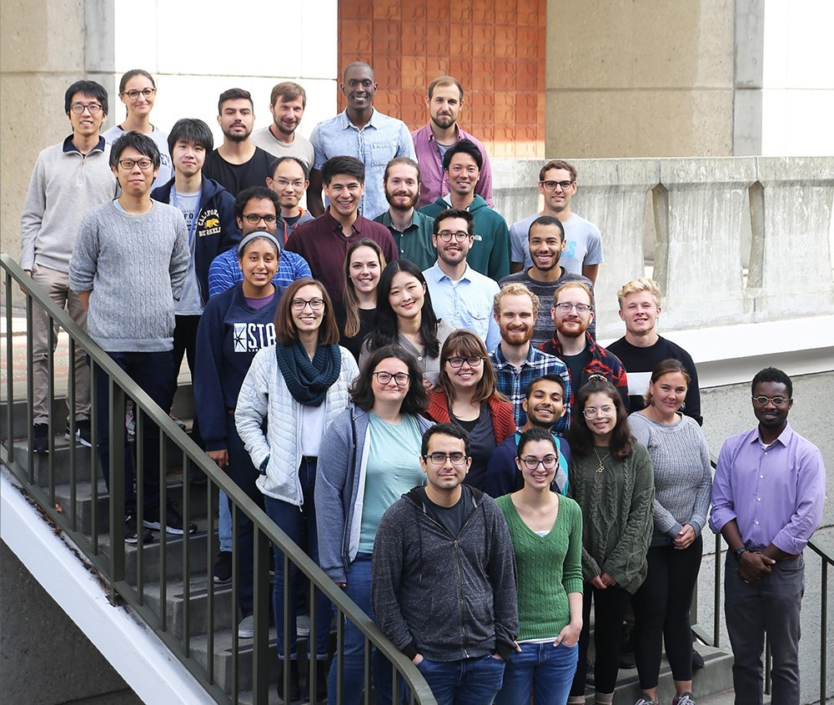
Acknowledgements
Prof. Richmond Sarpong
Sarpong group
Dr. Hasan Celik (NMR)
Dr. Nick Settineri (X-ray)

